Slide 1


Why should you choose GCSE History?
“I picked history because I find knowing more about the past helps you understand the present more.”
Richard, Year 10
“I love history because I find it really interesting learning about peoples stories and discovering how relevant they are to society today.”
Romilly, Year 12
“I’ve always loved history, learning about the past and how it shapes our world today is very intriguing and the subjects taught at our school such as medicine really show the advancements made in humanity and how we’ve managed to live so long.”
Madi, Year 11

Slide 2
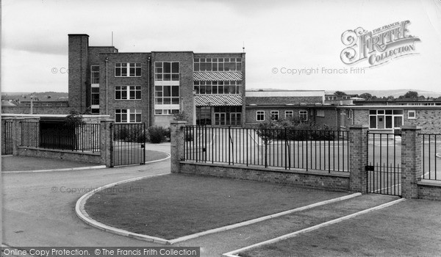

Why should you choose GCSE History?
Why study History?
There are many reasons that students choose to pick GCSE History at Thirsk.
  There are fascinating stories to learn of history from different period and places around the world. It is simply INTERESTING.
  It is a challenging subject that shows off the ability to organise and prepare as well as show high levels of analysis. Employers really RESPECT the subject, even if their job is not directly related to it.
  It is an opportunity to build on your ability to QUESTION the world around you today.
  The department teachers are all experts in the topics they teach and have a passion for teaching at this level.

Slide 3
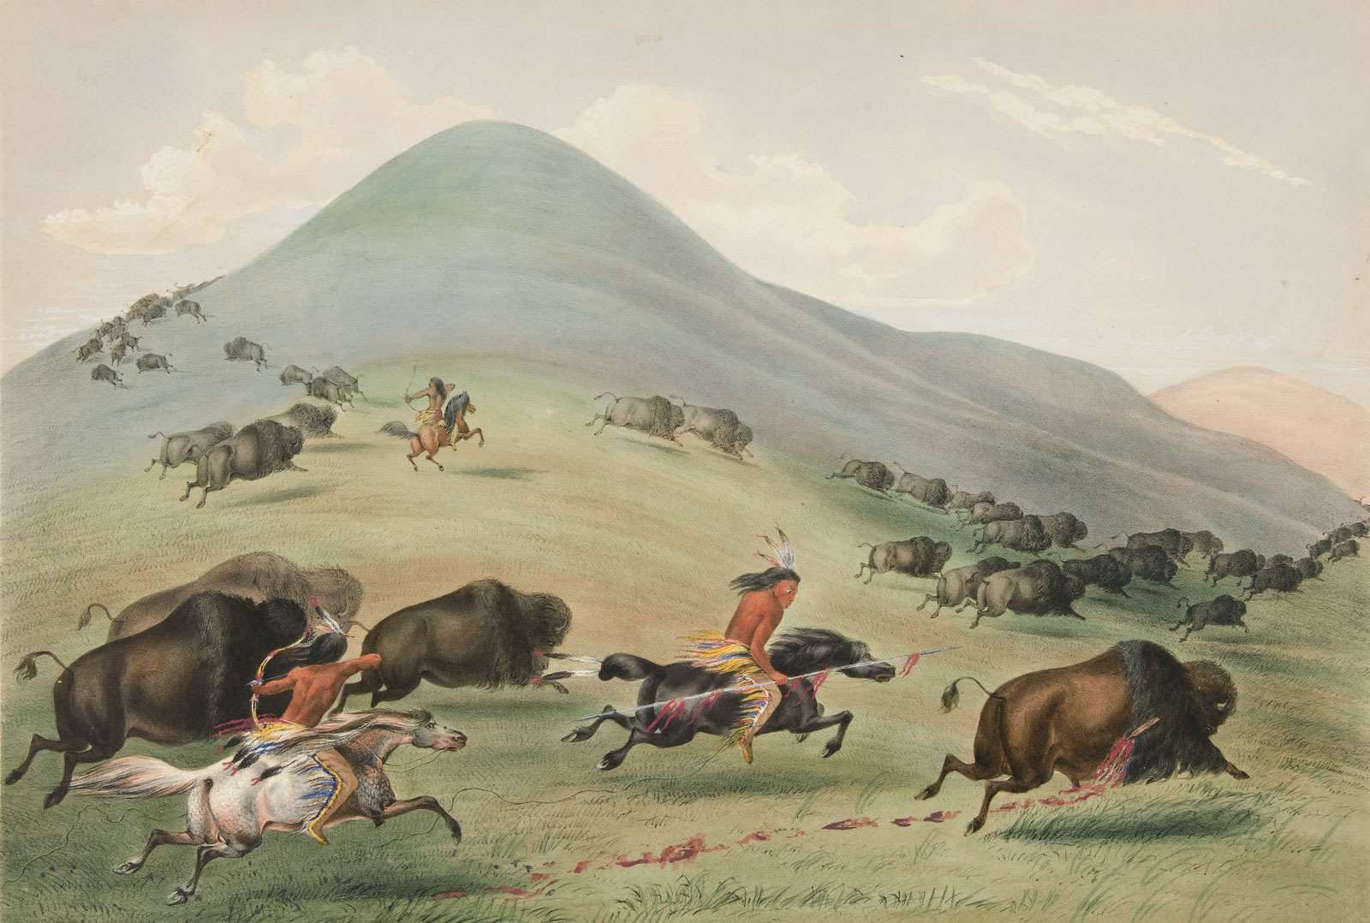
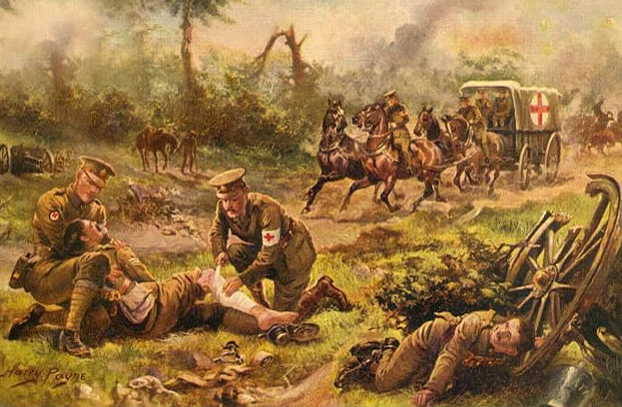
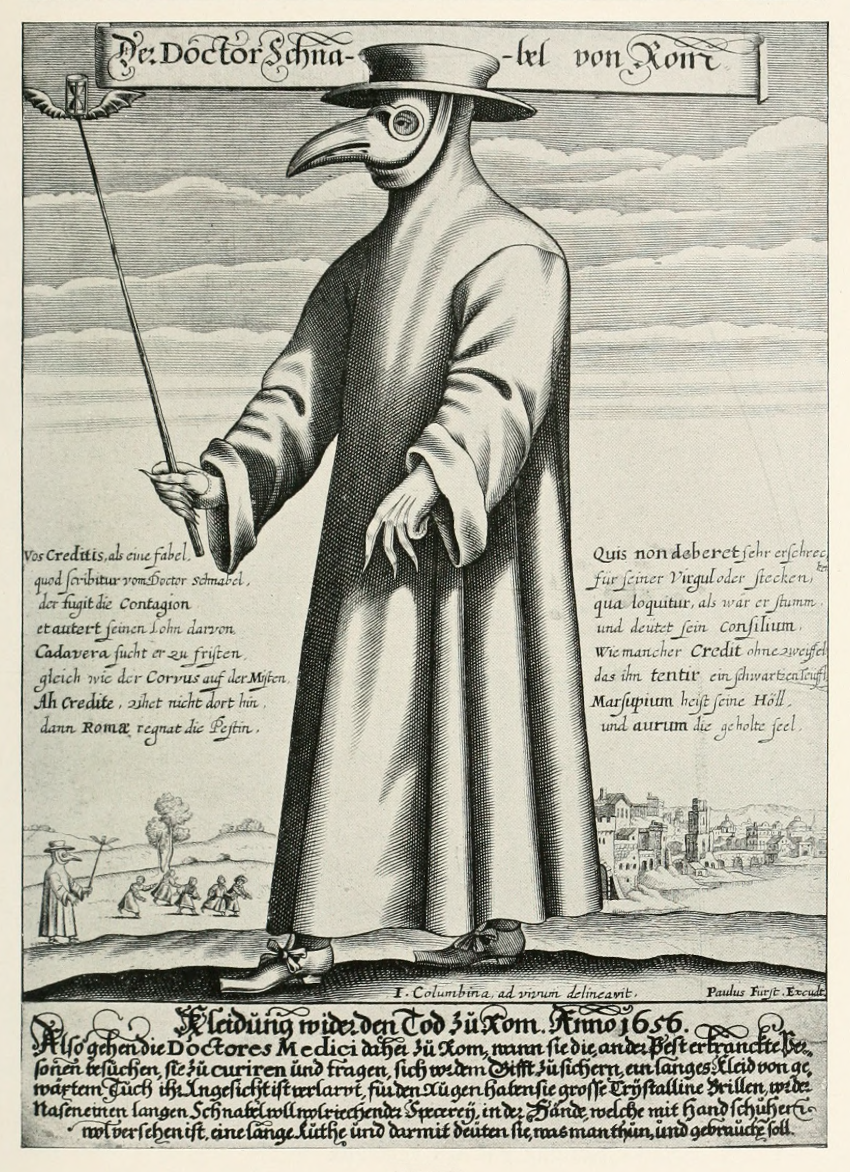
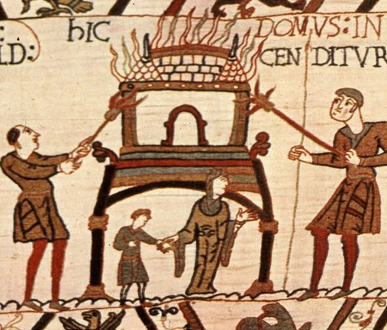
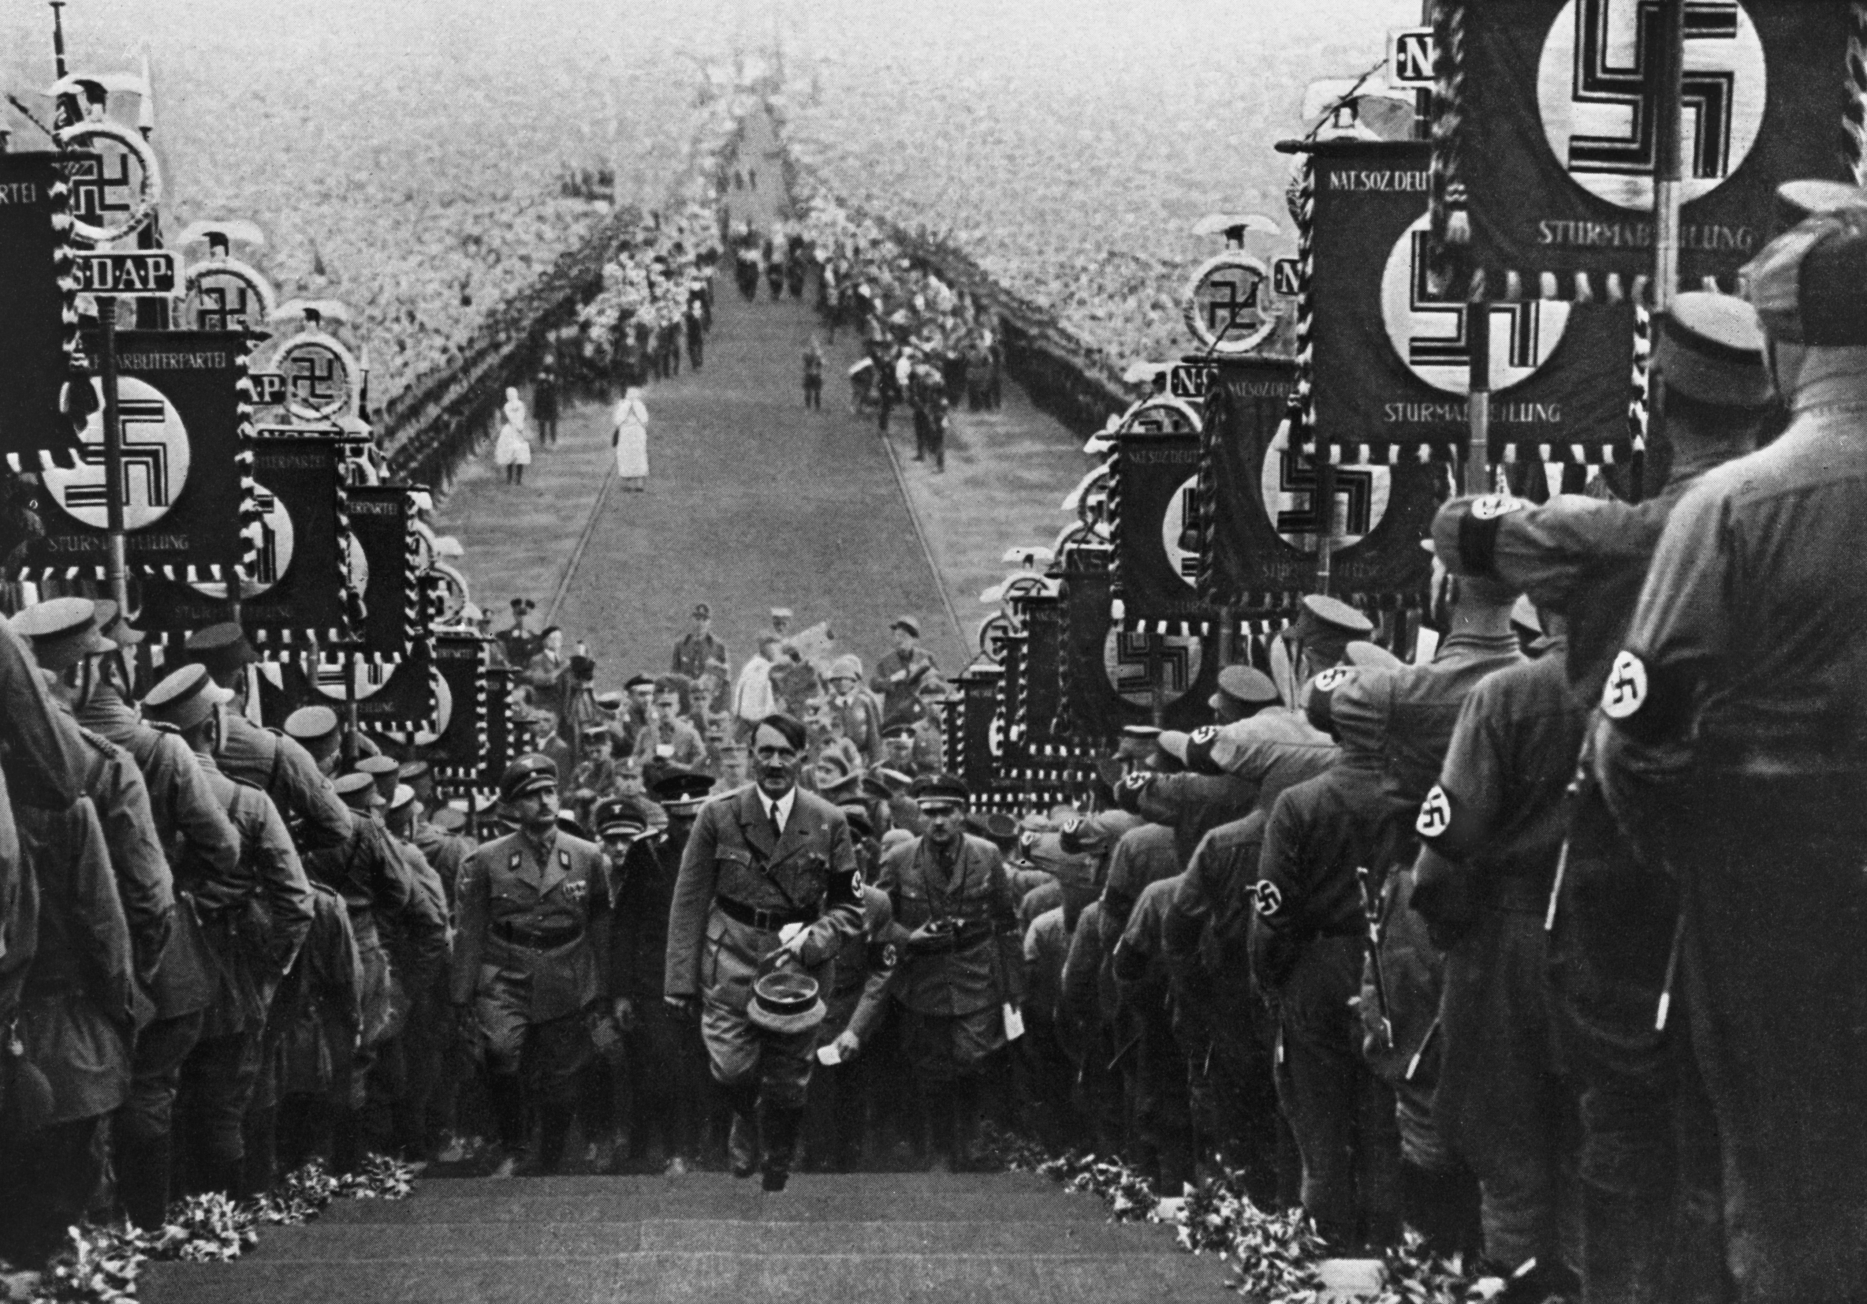
Why should you choose GCSE History?
There are four areas to GCSE History study:
  The American West, 1835-1895. This is ‘depth’ study of the decline of Indian society and the rise of America.
  Medicine, 1250-Present. This is ‘breadth study’, covering one topic over a huge time period. This is a fascinating class-favourite.
    Within this topic we study WWI Western Front treatments and injuries. This is a case study mainly focused on sources.
  Anglo-Saxon and Norman England 1060-1088. This is an English ‘depth’ study, covering one of the most important period of English history.
  Weimar and Nazi Germany, 1919-1939. This is the international ‘depth study’, covering the rise of Hitler and Nazi methods of control.

Slide 4
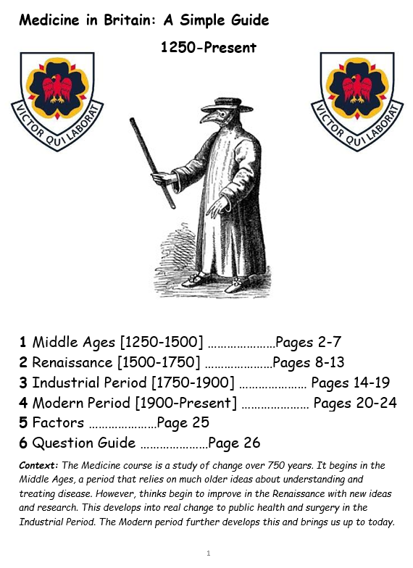
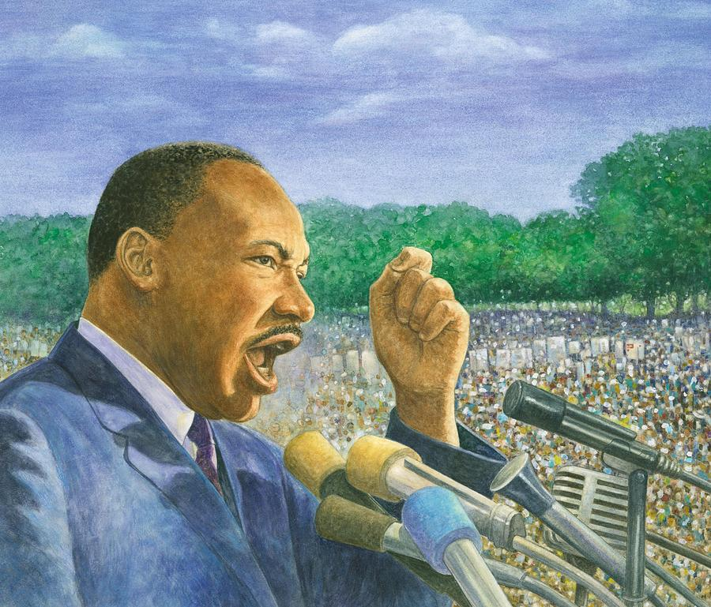

Why should you choose GCSE History?
You will learn four areas of skills, known as AO1, AO2, AO3 and AO4. These translate to:
  AO1: the ability to recall and apply relevant and accurate knowledge to an answer. This means you will need to know your facts, have good revision practice to back that up and to immerse yourself in topics confidently! FEATURES IN ALL FOUR TOPICS.
  AO2: the ability to explain and analyse content. This links to AO1, in that you must explain how your facts answer a question. This could be through impact, consequence, causation, similarity and difference. FEATURES IN ALL FOUR TOPICS.
  AO3: the ability to analyse and use sources to support historical study. FEATURES IN TWO TOPICS.
  AO4: The ability to understand and argue for and against historian’s viewpoints. FEATURES IN ONE TOPIC.

Slide 5
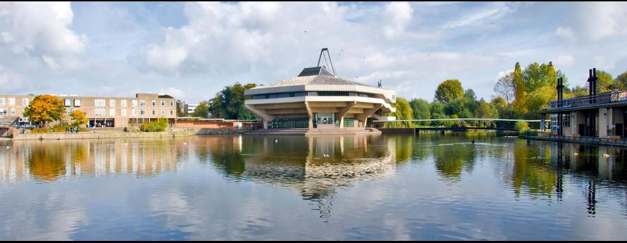
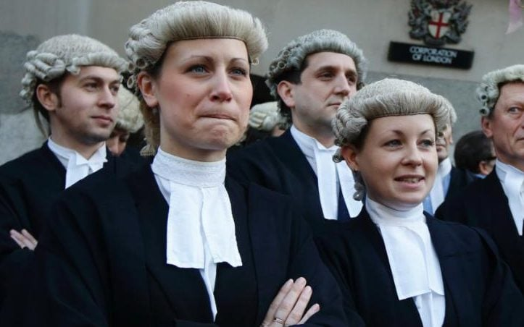

Why should you choose GCSE History?
A GCSE in History can open many doors:
  A Level History is taught at Thirsk and many other colleges and sixth forms. Most will want you to have studied the subject at GCSE.
  A degree in History will rely on having a GCSE in History.
  It is also considered a good GCSE for most other degree courses.
  GCSE History goes well with anyone interested in pursuing a career in administration, archiving, libraries, teaching, museum curation, writing, law, journalism etc.
  Most prime ministers and other politicians have a GCSE, A Level or degree in History.

Slide 6
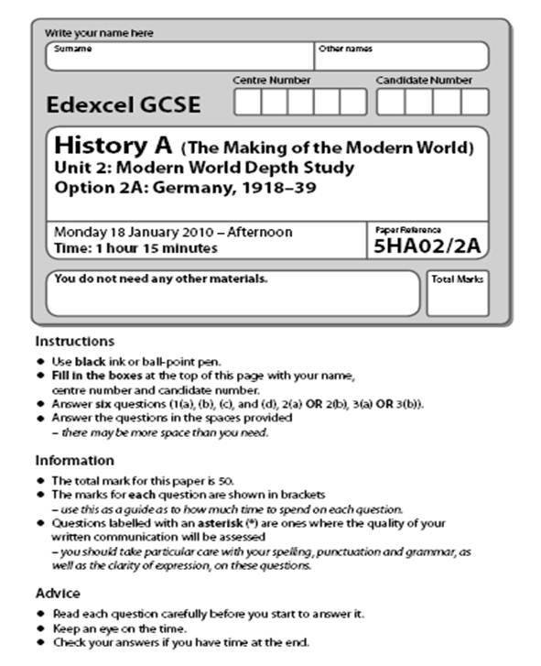
Why should you choose GCSE History?
In history there are two forms of regular assessment:
  Knowledge Tests. These are similar to your tests in Key Stage 3 history but the knowledge is based on a booklet for each topic. You will be expected to hit a good score on each one to show you are developing good revision practices.
  Exam questions. These will come in two forms.
    50% of these will be single exam questions sat with open book at the end of a mini-topic. You will be given feedback on these and a score.
    50% of these will be full paper assessments, sat in class. These will be exam-conditions and strong revision is expected.
There are also school-wide exam points such as the end of year 10 exams and the Y11 mocks.

Slide 7
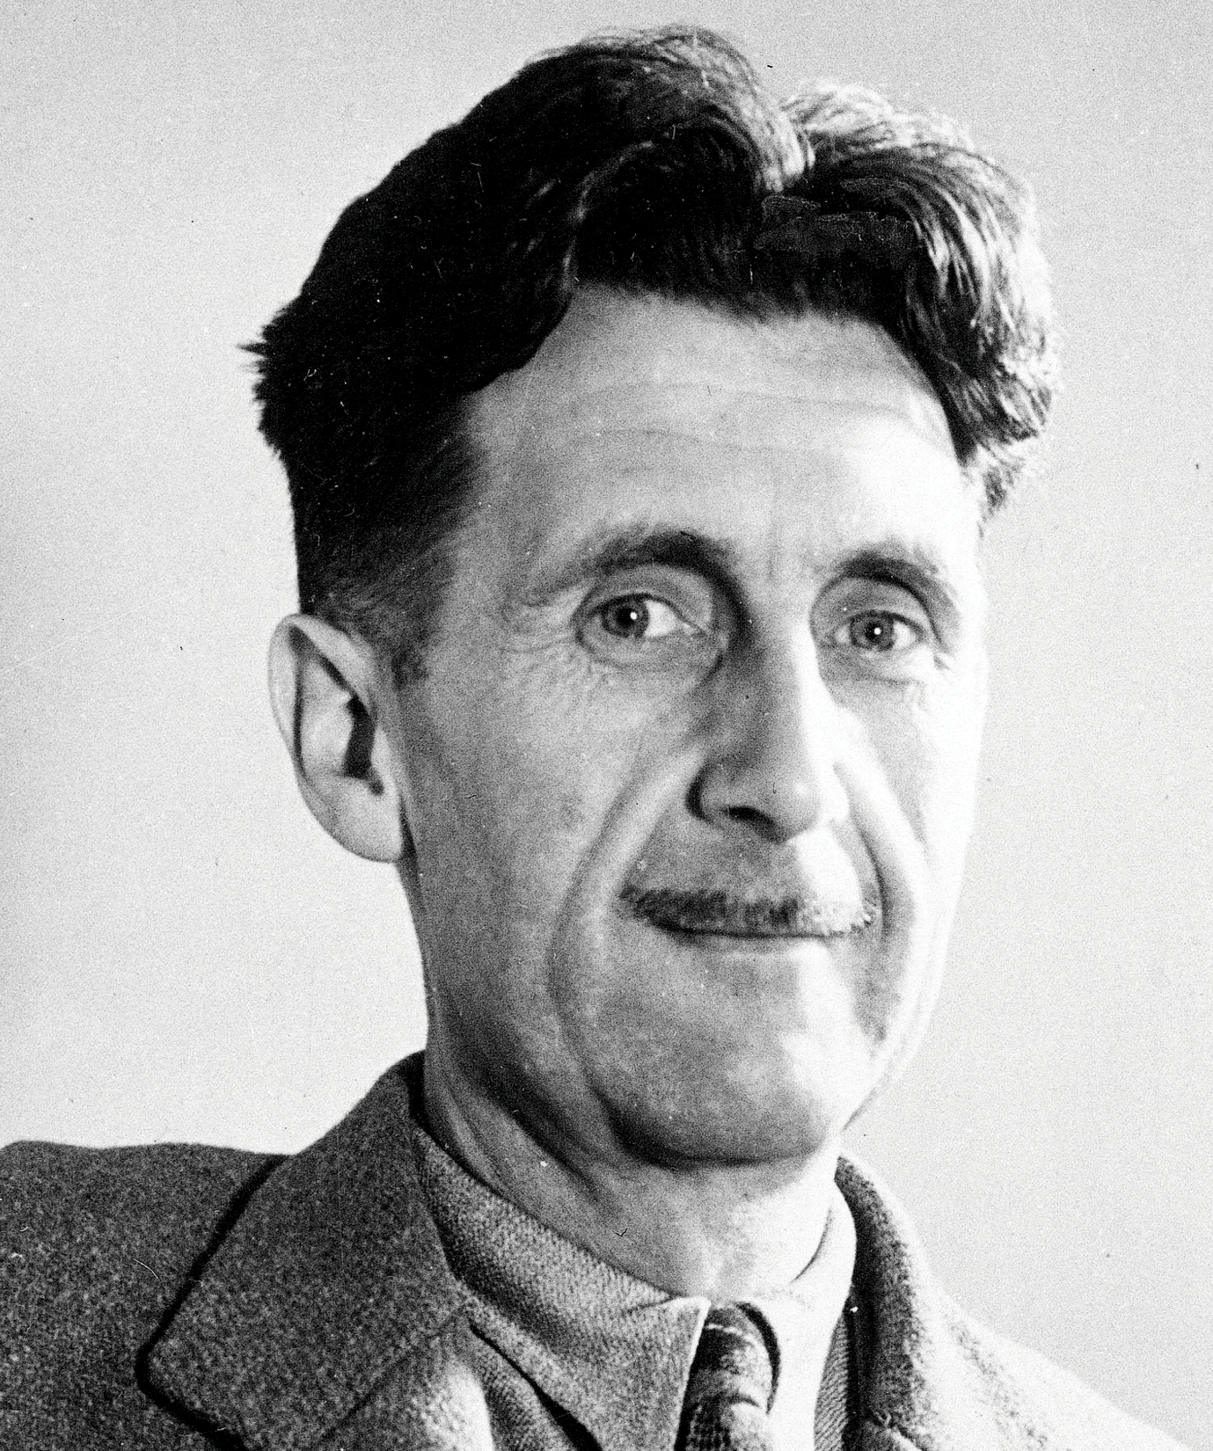
Why should you choose GCSE History?
“The further a society drifts away from the truth, the more it will hate those who speak it.”
George Orwell

Slide 8
Why should you choose GCSE History?
Thank you for reading and listening!
I am keen to answer any questions you might have about the course or studying History in general.
The best way to get in touch is via email: chris.Hansen@thirskschool.org

